Slide 1
Quiz Competition & Assessment Test
for
Career Counselling in Higher Education
Arranged By
Department of Mathematics
Mugberia Gangadhar Mahavidyalaya
Under DBT star college strengthening scheme, Govt. of India
Prepared by
Twameka Tripathi, Parthapratim Sahoo, Susmita Pahari ,
Sougata Bera, Sourav Bera,
Gouri Sankar Mandal, Ananya Pattanayak, Swarnendu Pradhan – PG 4th Sem Students 2022
under the supervision of …
Dr. Kalipada Maity
Associate Professor & HOD :: Dept of Mathematics
August 2022

Slide 2
IISER(Indian Institutes of Science Education &Research)
1) How many IISERs are there in India?
a) 4 b) 6
c) 7 d)none of these
2) According to nirf ranking which IISER is best?
a) IISER PUNE b) IISER KOLKATA
c) IISER MOHALI d) IISER BHOPAL
3) Which IISER is good for Mathematics?
a) IISER KOLKATA b) IISER THIRUVANANTHAPURAM
c) IISER MOHALI d) IISER TIRUPATI
4) Which IISER is located in West Bengal ?
a) IISER PUNE b) IISER KOLKATA
c) IISER BHOPAL d) IISER MOHALI

Slide 3
5) IISER KOLKATA offers courses for students in math background
a) 5year BS-MS dual degree program b) BS & MS program
c) Integrated PhD program d) All of these
6) IISER KOLKATA application process started for Autumn semester
a) April-May b) March-April
c) May-June d) June-July
Admission Channels:-(A candidate can apply through any one or two or all the three channels)
1) Kishore Vaigyanik Protsahan Yojana (KVPY)
2) JEE-Advanced
3) State and Central Boards Channel (SCB)
All IISERs offer Mathematics in their BS-MS course
For more details go and check their website…
https://www.iiseradmission.in/

Slide 5
Indian Statistical Institute(ISI)
( https://www.isical.ac.in/ )
7) How many ISI are there in India?
a) 5 c) 7
b)11 d) 6
It has four subsidiary centres focused in academics at
Delhi, Bengaluru, Chennai and Tezpur, and a branch at Giridih & KOLKATA(HQ)
8) ISI Kolkata conduct their entrance exam(masters) in which time?
a) March-May c) January- March
b) August-October d) April- June
9) Which ISI offers M.Math course after B.sc?
a) ISI KOLKATA c) ISI HYDERABAD
b) ISI MUMBAI d) ISI DELHI
10) After qualifying GATE exam one student get a chance to pursue
a) only P.HD c) only M.tech
b) M.Tech or P.HD d) none of these

Slide 6
11) ISI KOLKATA offers which courses for M.tech after M.sc math?
a) M Tech (CS) b) M Tech (CrS)
c) M Tech (QROR) d) all of these
12) Does ISI offer Junior/Senior Research Fellowship program?
a) yes b) No
13) Which ISI offers P.HD program in Mathematics ?
a) Kolkata b) Delhi
c) Bengaluru d) All of these
14) Who is the founder of ISI ?
a) Prasanta Chandra Mahalanobis b) Meghnad Saha
c) C.V. Raman d) Srinivasa Ramanujan
Does ISI have their own fellowship program for UG, PG students ?
a) yes b) No
For 1) B.Stat/B.math :- Rs. 5000/month ;
2) M.Stat/M.math/MS(QE)/MS(LIS)/MS(QMS):- Rs. 8000/month ;
3) M.Tech(CS/QROR/CrS):- Rs. 12400/month
** CrS: Cryptology and Security , QROR: Quality, reliability and operations Research

Slide 7
Ramakrishna Mission Vivekananda Educational and Research Institute/ Vivekananda University (RKMVERI) ( http://rkmvu.ac.in/ )
16) RKMVERI(Belur) offers a two year MSc degree programe
in Big Data Analytics (only for male) with
a) at least 60% in B.SC b) at least 70% in B.SC
c) at least 50% in B.SC d) at least 55% in B.SC
17) The syllabus for Big Data Analytics contains
a) Logical reasoning b) Quantitative Aptitude
b) Data Interpretation AND Data Visualization d) all of these
18) Admission process (RKMVERI) conducted in the time of
a) april-june b) January- March
c) August-october d) February-April
19) Which of the following courses are offered by RKMVERI ?
a) P.HD in Math b) M.SC in Computer Science
c) M.SC in Data Science d) All of these

Slide 8
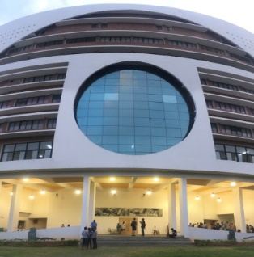
20) What is the full form of CMI ?
a) Chennai Mathematical Institute b) Cell mediated immunity
c) Communication media information d) Credit manager’s index
21) CMI was founded in
a) 1989 b) 1990
c) 1987 d) none of these
22) CMI offers UG PG and PHD course in
a) Mathematics b) Statistics
c) Computer Science d) all of these
23) CMI was situated in
a) Cochin b) Kolkata
c) Chennai d) none of these
( https://www.cmi.ac.in/ )

Slide 9
24) Who can apply for the course M.SC in Data Science in CMI ?
candidates having UG degree with background in
a) Mathematics b) Statistics
c)Computer Science d) all of these
25) Application process started in between
a) March –May b)April –June
c) July-September d) January –March
26) The CMI has invited PhD Mathematics candidates directly for interview who have qualified for the scholarship of
a) NBHM b) CSIR
c) GATE d) none of these
27) Does CMI offers campus placement ?
a) yes b) no

Slide 10
Banaras Hindu University(BHU)
( https://www.bhu.ac.in/ )
28) BHU conduct their M.SC admisssion through
a) JAM score b) conducting their own entrance(UET,PET )
c) GATE score d) none of these
29) Application process started in between
a) April-July b) March –June
c) July-September d) January –March
30) University in Varanasi located in
a) Uttar Pradesh b) Bihar
c) Panjab d) Haryana
31) Eligibility criteria for BHU M.SC entrance with UG percentile
a) 60% b) 65%
c) 70% d) 50%

Slide 11
University of Hyderabad(HCU)
( http://acad.uohyd.ac.in/ )
32) Candidates are eligible for admission in PhD course through
a) UGC-CSIR JRF b) NBHM
c) a)&b) both d) a) or b)
33) HCU offers offers M.Sc. courses in the stream of
a) Mathematics b) Applied Mathematics
c) Statistics-Operations research d) all of these
34) Each admitted student who do not possess any fellowship from any
other agency will be paid a Fellowship/ Scholarship of Rs.
a) 1000/month b) 6000/month
c) 1500/month d) 2000/month
35) The top two students get the University Achievers awards of Rs.
a) 1500/month b) 2000/month
c) 6000/month d) 3000/month

Slide 12
36) For applying for the M.Sc Courses in HCU a candidate should have B.SC degree in Math/ Statistics with percentile
a) 55% b) 60%
c) 50% d) 65%
37) HCU conduct their M.SC admisssion through
a) conducting written entrance test b) interview
c) by both a) & b) d) JAM score
38) Application process started in between
a) May-July b) March –June
c) July-September d) January –March
39) University of Hyderabad located in
a) Telangana b) Jharkhand
c) West Bengal d) Tamilnadu
40) Which of the following is not a central university?
a) Banaras Hindu University b) University of Hyderabad
c) Delhi University d) ISI KOLKATA

Slide 13
Harish-Chandra Research Institute (HRI) ( http://www.hri.res.in/ )
41) HRI located in
a) Allahabad b) Hyderabad
c) Kolkata d) Chennai
42) HRI is a premier institution dedicated to research (P.hD) in
a) Mathematics b) Theoretical Physics
c) Chemistry d) a)&b) both
43) In HRI the areas of focus in Mathematics are
a) Algebra, b) Analysis
c) Geometry & Number Theory d) All of these
44) In HRI online application for PhD commences in the month of
a) July c) August
c) May d) June

Slide 14
Candidates will be eligible to appear for the Admission Exam for the HRI Ph.D Programme through
a) NBHM scholarship b) UGC-CSIR Fellowship (AIR 1-20)
c) Interview d) All of these
46) The Institute (HRI) has recently started an M.Sc. Programme in
a) Physics b) Mathematics
c) Chemistry d) All of these
47) HRI offers SPIM( Summer program in Mathematics ) in the month of
a) April-May b) March-April
c) May-June d) June-July
Candidates should apply for SPIM before
a) May b) June
c) July d) April
49) HRI was founded in
a) 1975 b) 1976
c) 1974 d) 1977

Slide 15
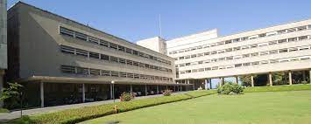
Tata Institute of Fundamental Research(TIFR)
( https://www.tifr.res.in/ )
50) TIFR was founded on
a) 1st June 1945 b) 1st June 1946
c) 1st June 1947 d) 1st June 1985
51) Who was the founder of TIFR with the help of whom ?
a) Dr. Homi J. Bhabha & J.R.D Tata b) Vikram Sarabhai
c) C.V Raman d) Satyendranath Bose
52) The School of Mathematics at TIFR Mumbai conducts research in Mathematics with emphasis on
a) Pure mathematics b) Applied mathematics
c) Geometry d) all of these
53) TIFR Mumbai is organizing a two-week summer school in mathematics named
a) Vigyan Vidushi (for women ) b) Vigyan Mancha
c) Vigyan Shibir d) All of these

Slide 16
54) TIFR online application starts in
a) October-November b) June-July
c) March-April c) May-June
55) TIFR main campus is
a) TIFR Mumbai b) TIFR Hyderabad
c) CAM Bengaluru d) HBCSE Mumbai
** Top institutes for higher studies in Mathematics
1) IISC ( https://iisc.ac.in/ )
2) ISI KOLKATA ( https://www.isical.ac.in/ )
3) IISERs ( https://www.iiseradmission.in/ )
4) TIFR (They have their own fellowship program also )
( https://www.tifr.res.in/ )
5) CMI ( https://www.cmi.ac.in/ )
6) IMSC ( https://www.imsc.res.in/ )
7) HRI ( http://www.hri.res.in/ )
8) NISER ( https://www.niser.ac.in/ )
9) IITs & NITs (Warangal & Trichy )

Slide 17
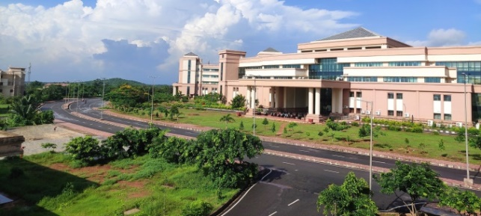
NATIONAL INSTITUTE OF SCIENCE EDUCATION AND RESEARCH BHUBANESWAR
(NISER) ( https://www.niser.ac.in/ )
56) Online application starts in NISER in the month of
a) April b) May
c) March d) June
57) Candidates are eligible for P.hD with having marks in M.SC
a) 60% b) 70%
c) 65% d) 80%
58) Candidates should have qualified for P.hD admission
a) CSIR-UGC-NET JRF b) GATE
c) NBHM d) at least one of these
59) NISER BHUBANESWAR offer courses on
a) Int. M.sc P.hD in Math b) M.sc in Math
c) P.hD in Math d) both a) & c)

Slide 18
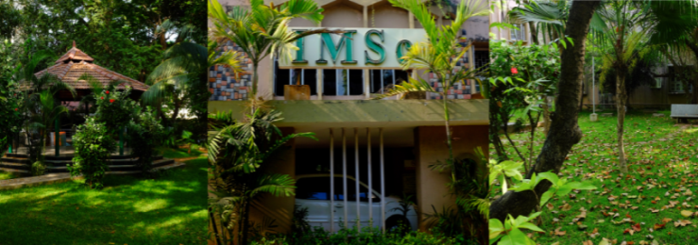
The Institute of Mathematical Sciences(IMSC)
( https://www.imsc.res.in/ )
60) IMSc provides exceptional intellectual environment for
fundamental research in the areas of
a) Theoretical Physics ` b) Mathematics
c) Theoretical Computer Science d) all of these
& Computational Biology
61) IMSC application deadlines usually fall in
a) Mid-February b) Mid-August
c) Mid-January d) Mid-May
62) IMSC offers P.hD program to the candidates who have qualified
a) NBHM b) GATE
c) NET d) any of those
63) IMSC offers summer research program in in month of
a) May-July b) July-September
c) April-June d) June-August

Slide 19
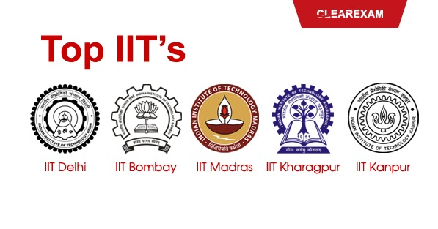
Indian Institutes of Technology(IIT)
( https://www.iitsystem.ac.in/ )
64) How many IITs are there in all over the India?
a) 23 b) 24
c) 20 d) 21
65) How to get an admission in P.hD Math in IIT ?
scoring good marks in
a) Csir NET-Jrf b) GATE
c) any of the above or clearing
the written test & interview conducted by d) NBHM
individual IIT
66) Which IIT is the oldest ?
a) IIT Kharagpur b) IIT Kanpur
c) IIT Madras d) IIT Delhi
67) How to get admission for M.SC in IITs?
a) through JAM b) through GATE
b) through NET d) through NBHM

Slide 20
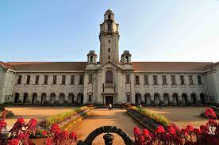
68) IISC offers integrated P.hD program with eligibility
a) 60% marks in B.sc b) Good score in JAM(MA)
c) any of those d) both a) & b)
69) According to NIRF ranking which one is the top university ?
a) IISC b) BHU
c) CMI d) none of these
70) Among 1587 govt. institutions worldwide CSIR ranked
a) 37th b) 38th
c) 39th d) 35th
71) CSIR ranked in ASIA
a) 7th b) 8th
c) 9th d) 10th
72) For joining ISRO scientist –SC (entry level) basic qualification is
a) M.SC b) B.SC
c) P.hD d) none of these

Slide 21
73) Which ISI offers Bachelor’s degree ?
a) ISI KOLKATA (B.Stat,B.Math) b) ISI BANGALORE (B.Math)
c) ISI CHENNAI d) all of these
74) Where is ISI headquarter ?
a) ISI KOLKATA b) ISI CHENNAI
c) ISI BANGALORE d) ISI DELHI

Slide 22
* List of Best Internship Websites in India
1) Internshala
2) LinkedIn
3) Google Summer of Code( GSoC )
4) Google's Coding Competitions ( Hash code
, Code Jam, Kick-Start)
5) Chegg
* Required coding Language
1) Java
2) C, C++
3) Python
** Any two of those

Slide 23
75) Best NIT for MSc Mathematics
a) NIT Warangal b) NIT Trichy
c) NIT Rourkela d) NIT Surathkal
76) IISC situated in
a) Bengaluru b) Chennai
c) Tamil Nadu d) Kerala
77) NIT Warangal is best for
a) Applied Mathematics b) Pure Mathematics
c) Physics d) All of these
78) NIT Warangal offers course in Mathematics and Scientific Computing which is
a) M.Sc course b) B.sc Course
c) M.tech Course d) MS course
Some IITs offer M.tech course for M.sc Math students through gate are
a) IIT Kharagpur b) IIT Madras
b) IIT Guwahati d) All of these

Slide 24
80) Which IIT is good for Applied Mathematics ?
a) IIT Kanpur b) IIT Delhi
b) IIT Kharagpur d) IIT Bombay
Recently which IIT started a 3 years online B.sc program in Data Science ?
a) IIT Madras b) IIT Bombay
c) IIT Kharagpur d) IIT Guwahati
Some Institutes dedicated only for Mathematics
a) ISI KOLKATA b) CMI
c) IMSC d) TIFR Mumbai
e) All of these
Which IIT offers MSc-Ph.D dual degree in Operations Research for math students
a) IIT Bombay b) IIT Kharagpur
c) IIT Guwahati d) All of these
84) Which IIT is best for Pure Mathematics ?
a) IIT Kanpur b) IIT Delhi
b) IIT Kharagpur d) IIT Bombay
85) IISC offers integrated M.SC-P.hD program for the candidates who qualify
a) JAM b) GATE
c) NBHM d) All of these

Slide 25
Some other institutes for their finest research program in Mathematics
1) Institute of Mathematics & Applications, Bhubaneswar ( Integrated PhD& P.hD) ( https://iomaorissa.ac.in/admissions/ )
2) Kerala School of Mathematics( offers Integrated
MSc-PhD & P.hD Program) (a center of excellence
research in Mathematics) ( https://ksom.res.in/ )
3) Indian Institute of Space Science and Technology ( IIST), Thiruvananthapuram, Kerala (P.hD in Mathematics) ( https://www.iist.ac.in/ )
4) The Centre for Excellence in Basic Sciences (CEBS), Mumbai ( research in Mathematics )
( https://www.cbs.ac.in/research/research-mathematics )
5) Birla Institute of Technology & Science, Pilani (BITS Pilani) ( Offers M.SC Math )
( https://www.bits-pilani.ac.in/hyderabad/mathematics/Courses )
6) INSTITUTE OF CHEMICAL TECHNOLOGY ( ICT ), MUMBAI (p.hd in math)
( https://www.ictmumbai.edu.in/DepartmentHome.aspx?nDeptID=ca )

Slide 26
86) Who can apply in the summer research program
currently pursuing B.SC/M.SC degree in the 2nd and 3rd year / 1st year of their course with a good CGPA .
87) Some good Math Internship in INDIA
a) At TIFR
b) SPIM at HRI
c) at CMI
d) IITs
e) IMSC
88) Full form of NBHM
National Board for Higher Mathematics (http://www.nbhm.dae.gov.in/node/38 )
89) CSIR full form ( https://www.csir.res.in/ )
Council of Scientific & Industrial Research
90) GATE full form ( https://gate.iitkgp.ac.in/ )
Graduate Aptitude Test in Engineering
** JAM : Joint Admission Test for M.SC ( organising institute IIT Guwahati for 2022)
( https://jam.iitr.ac.in/ )

Slide 27
91) GATE exam conducted in a year for how many times ?
a) one b) two
c) three d) four
92) Form fill up started for GATE in which time ?
a) Aug-Oct b) Jan-Feb
c) April-June d) May-June
93) GATE exam conducted in the month of
a) February c) December
c) November d) January
94) Among the following options which exam is only for M.Sc?
a) JAM b) GATE
c) NET d) a)&b) both
95) Among the following options which exam is for Masters as well as P.hD?
a) JAM b) GATE
c) NET d) a)&b) both
96) Organising Institute for GATE 2023 is
a) IIT Kanpur c) IIT Delhi
c) IIT Bombay d) IIT Kharagpur

Slide 28
96) What is the full form of JAM?
a) Joint Admission test for Masters b) Joint Application Manager
c)Joint account for Mutual funds d) none
97) Form fill up started for JAM in which time ?
a) Sep-Oct b) Jan-Feb
c) April-June d) May-June
98) JAM exam conducted in the month of
a) February c) December
c) November d) January
99) Among the following options which exam is conducted twice in a year?
a) GATE b) NET
c) JAM d) JEE
100) NET exam conducted in the month of
a) June & December c) January & July
c) May-November d) April-October
101) Through which exam one get admission in P.hD?
a) NET b) GATE
c) JAM d) a)&b) both

Slide 29
102) In ISRO a Post Gradute Mathematics student join as
(a) Director (b)Scientists
(c) Technician (d) Designer
103) The recruitment procedure is
(a) Direct joining (b) By recommendation
(c) Written test,interview (d) Merit based
104) In ONGC you can get a job as AEE (Reservoir) after qualifying
(a)GATE (b) NET
(c) CAT (d) NBHM
105) You can get MRFP fellowship from Indian Institute of Tropical Meteorology (IITM) Pune after qualifying
(a)NET/GATE (b) SSC CGL
(c) RRB Exam (d) UPSC
106) The duration of Fullbright scholarship is
(a) One year (b) Two years
(c) Six to nine months (d) Five month

Slide 30
107) Which country gives DAAD scholarship for M.Sc and
PhD program
(a) England (b)Germany
(c) America (d) India
108) The application Starts from
(a) Aug-Oct (b) Nov-Dec
(c) Jan-Feb (d) May-Jun
109) Google Ph.D fellowship is given for doing Ph.D in
(a) Analysis (b) Geometry
(b) Mechine learning (d) Algebra
110) One can get admission in MBA,PGP,PGDM courses by qualifying
(a) UPSC (b) JAM
(c) GATE (d)CAT
111) The CAT exam is conducted by
(a) IIM (b) IIT
(c) SSC (d) CSC

Slide 31
112) The minimum eligibility for CAT exam is
(a)B.Sc (b) M.Sc
(c) 12th (d) 10th
113) The registration starts generally in
(a) January (b) March
(c) October (d) August
114) It is conducted in a year
(a) Twice (b) Four times
(c) Once (d) Thrice
115) One can attempt this exam
(a) 2,times (b) Unlimited times
(c) 4,times (d) 6,times
116) The validity of CAT scorecard is
(a) One year (b) Lifetime
(b) Two years (d) Five years

Slide 32
117) The form fill up of GATE exam starts from
(a)Aug-Sept (b)J an-Feb
(b) Nov-Dec (d) None of them
118) The exam Conducts in the month of
(a) Oct (b) Dec
(c) May (d) Feb
119) The minimum eligibility of the exam is
(a)B.Sc(Final year) (b) M.Sc
(c) 12thpass (d) 8thpass
120) Is there any age limit of this exam
(a) Yes (b) No
121) The validity of GATE scorecard for admission in a instituion is
(a) Three years (b) Lifetime
(c) one year (d) none of these

Slide 33
122) It is conducted in a year
(a)Twice (b) Four times
(c)Once (d)Thrice
123) The CSIR-NET is conducted in a year
(a)Twice(Jun,Dec) (b) None of them
(c) Once(May) (d) thrice ( May, June, July )
124) The application for NET-JUNE starts from
(a) April-May (b) Feb-March
(c) Sep-Oct (d) Jun-July
125) The application for NET-DEC starts from
(a) April-May (b) Feb-March
(c) Sep-Oct (d) Jun-July
126) The minimum eligibility for this exam is
(a)B.Sc (b)12th
(c)10th (d)M.Sc(Final year)

Slide 34
127) The validity of NET-JRF scorecard is
(a) Two years (b) Four years
(c) Lifetime (d) None of them
128) The validity of NET-LS scorecard is
(a) Two years (b) Four years
(c) Lifetime (d) None of them
129) The application for M.Sc program through National Board for Higher Mathematics(NBHM) starts from generally
(a) August (b) March
(c) December (d) July
130) The application for Ph.D program through National Board for Higher Mathematics(NBHM) starts from generally
(a) August (b) March
(c) December (d) July
131) Is there any age restriction of this exam
(a) Yes (b) No

Slide 35
132) The validity of NBHM scorecard for admission in a instituion is (a) Two years (b) Five years
(c) One year (d) Lifetime
133) The application for B.Sc, M.Sc,Ph.D program in Chennai Mathematical Institute(CMI) starts from generally
(a) August (b)March
(c) December (d)July
134) Aryabhatta Postdoctoral Fellowship: ARIES is given for
(a) P.hD degree holder (b) M.sc degree hodegreeholder
(c) B.sc degree holder (d)Madhyamic degree holder
135) Aryabhatta Postdoctoral Fellowship: ARIES Is given for
a) Only Mathematics students (b) Only Engineer students
c)Both (d) Others
136) Aryabhatta Postdoctoral Fellowship: ARIES Is given for the age of
(a) Not more than 35 years (b) Not more than 42 years
(c) Not more than 52 years (d) Not more than 52 years

Slide 36
137) IST-BRIDGE International Postdoctoral Program is given for
(a)Ph.D degree or equivalent (b) B.sc students only
(c) M.sc students only (d) H.sc Students only
138) IST-BRIDGE International Postdoctoral Program is given for
a)Mathematical and physical Sciences
b) Life Science
(c) Information and system science
(d) All of the above
139) ETH Zurich Research Grants: Doctoral Project: is given for
(a) P.hd students Only (b) M.sc students Only
(c) B.sc students Only (d) Madhyamik Student only
140) The website of ETH Zurich Research Grants: Doctoral Project; is
www.ethgrants.ethz.ch
www.ethgeantp.ethz.ch
www.schorship.ethz.ch
(d) https://www.buddy4study.com/

Slide 37
141) ETH Zurich Research Grants: Doctoral Projects Duration time is
(a) 3 years(max) (b) 5 years(max)
(c) 8 years(max) (d) 9 years(max)
142) The Level of ETH Zurich Research Grants: Doctoral Projects is
(a) P.hD degree only
(b) Master degree only
(c) Graduations students only
(d) H.sc students only
143) The deadline of ETH Zurich Research Grants: Doctoral Projects is
(a) March & September
(b)January and February
(c) March and April
(d) December and January
144) Postdoctoral Fellowship Program IIT-K is given by
(a) Indian Institute Of Technology Kanpur
(b) Indian Institute of Technology Madras
(c) Indian Institute of Technology Delhi
(d) Indian Institute of Technology Bombay

Slide 38
145) Fellowship level of Postdoctoral Fellowship Program IIT-K is
(a) Postdoctoral (b) Doctoral
(c) M.sc (d) B.sc
146) Which Country Provides Postdoctoral Fellowship Program IIT-K?
(a) India (b) Japan
(c) China (d) USA
147) Subject Area of Postdoctoral Fellowship Program IIT-K is
(a) Science & Engineering (b) History
(c) Geography (d) Others
148) Elligibility of Postdoctoral Fellowship Program IIT-K is
(a)Ph.D degree with experience
(b) M.sc degree with experience
(c) B.sc degree with experience
(d) Madhyamik degree with experience
149) Deadline of Postdoctoral Fellowship Program IIT-K is
(a) March-April (b) Rolling Advertisement
(c) January-February (d) November-December

Slide 39
150) 100 prime Minister’s doctoral Research Fellowships is given by
(a) Government of japan (b) Government of india
(c)Government of usa (d)Government of china
151) 100 prime Minister’s doctoral Research Fellowships is given to the student of
(a) Post Doctoral (b) Doctoral
(c) Graduate (d)Post Graduate

Slide 40
Science and Engineering Research Board ( SERB )
Providing support to carry out research in emerging and frontier areas of science and engineering. Also provide financial assistance to persons engaged in such research, academic institutions, research and development laboratories, industrial concerns and other agencies.
152) Is SERB a Statutory Body ?
a) Yes b) No
153) SERB focuses in the area of promoting basic research in
a) Science and Engineering b) Arts
c) Economics d) none
154) SERB launched a scheme spacially promoting opportunities for womens called
a) SERB-POWER b) SERB-N-Pdf
c) SERB Women Excellence Award d) MATRICS
Note:- 1) "SERB Women Excellence Award“ ( eligibility )
a) age: below 40
b) only for women
c) Applicant must be having recognition from any one or more of the following national academies such as Young Scientist Medal, Young Associate etc.

Slide 41
d) Candidates have excelled in science and got recognition from any of the National Science Academies (given below) in India.
1) Indian National Science Academy, New Delhi
2) Indian Academy of Science, Bangalore
3) National Academy of Science, Allahabad
4) Indian National Academy of Engineering, New Delhi
5) National Academy of Medical Sciences, New Delhi
6) National Academy of Agricultural Sciences, New Delhi
e) Research grant of Rs. 5 lakhs per annum and Rs. 1 lakh per annum as overhead charges for a period of three years.
2) “SERB-POWER” ( eligibility )
Two types of grant
Level I: The scale of funding up to 60 Lakhs for three years. (for Applicants from IITs, IISERs, IISC, NITs, Central Universities, and national Labs of Central government Institutions)
Level II: The scale of funding up to 30 Lakhs for three years. (for applicants from state Universities/ Colleges and Private Academic Institutions)
155) The mode of application in the SERB portal is
a) online b) Offline
c) Both d) any one
156) SERB launched schemes spacially for young researchers called
a) SERB-N-Pdf b) Startup-research grant(SRG)
c) SUPRA d) SERB-STAR

Slide 42
157) A scheme for Mathematical Research Impact Centric Support through SERB Called
a) SERB-POWER b) SERB-N-Pdf
c) SRG d) MATRICS
158) In MATRICS amount of Research grant is
a) Rs. 2 lakh p.a. for a period of three years
b) Rs. 5 lakh p.a. for a period of two years
c) Rs. 10 lakh p.a. for a period of three years
d) Rs. 4 lakh p.a. for a period of five years
159) The Ramanujan Fellowship is given to the brilliant Indian scientists and engineers who wants to come from
a) Abroad to India & below 40years
b) India to Abroad & below 40years
160) The JC Bose fellowship is awarded to active scientists
a) who are awarded by SS Bhatnagar prize and/or fellowship of science academies
b) which can be availed up to 68 years of age
c) normally twice a year periodically
d) All statement are correct

Slide 43
Shanti Swarup Bhatnagar Prize for Science and Technology (SS Bhatnagar prize )
The Shanti Swarup Bhatnagar Prize for Science and Technology (SSB) is a science award in India given annually by the Council of Scientific and Industrial Research (CSIR) for notable and outstanding research, applied or fundamental, in biology, chemistry, environmental science, engineering, mathematics, medicine, and physics.
The award is named after the founder Director of the Council of Scientific & Industrial Research, Shanti Swarup Bhatnagar & It was first awarded in 1958.
It is the most coveted award in Multidisciplinary science in India.
Any citizen of India engaged in research in any field of science and technology up to the age of 45 years is eligible for the prize & The prize is awarded on the basis of contributions made through work done in India only during the five years preceding the year of the prize.
The prize comprises a citation, a plaque, and a cash award of ₹5 lakh (US$6,300). In addition, recipients also receive Rs. 15,000 per month up to the age of 65 years.

Slide 44
OTHER FUNDING OPPORTUNITIES through SERB
For more details go & check their website ( https://www.serbonline.in/ )

Slide 45
The Indian National Science Academy (INSA)
( https://www.insaindia.res.in/ )
161) The main object of The Indian National Science Academy (INSA) is
a) promoting science in India b) harnessing scientific knowledge
c) a)&b) both d) neither a) nor b)
162) The Indian Journal of Pure and Applied Mathematics (IJPAM) is published by
a) INSA b) INSPIRE
c) SERB d) none of these
163) Another journal other than IJPAM published by INSA which is
a) Indian Journal of History of Science (IJHS)
b) Indian Journal of Mathematics and Science (IJMS)
c) Indian Journal of Science (IJS)
d) All of the above
164) The National Institute of Sciences of India was renamed as Indian National Science Academy in the year
a) 1970 b) 1975 c) 1971 d) 1990

Slide 46
165) INSA JRD-TATA fellowship provides annually about 10 Fellowships to the young scientists, teachers and researchers for max 3 months below 45 years who possessing
a) Doctorate b) M.sc/equivalent degree
c) B.sc d) a) & b) both
166) The India Science and Research Fellowship (ISRF) is to provide opportunity to scientists and researchers from
a) neighbouring countries to India
b) India to neighbouring countries (Afghanistan, Bangladesh, Bhutan, Maldives, Myanmar, Nepal, Sri Lanka and Thailand )
167) The Prize Indira Gandhi Prize for Popularization of Science shall be awarded a) once in three years b) once in two years
c) twice in three years d) twice in four years
168) The Prize Indira Gandhi Prize for Popularization of Science is given in the field of
a) popularization of science in any Indian language, including English
b) popularization of science in any Indian language, including Bengali
c) popularization of Mathematics
d) popularization of science

Slide 47
169) The prize money for the award of Indira Gandhi Prize for Popularization of Science is Rs.
a) 25,000/- , citation and a bronze medal
b) 50,000/- , citation and a silver medal
c) 25,000/- , citation and a silver medal
d) 5,000/- , citation and a gold medal
170) International Travel Support (ITS) Scheme provides financial assistance to Indian researchers for presenting a research paper in an international scientific event held abroad with age group of
a) below 35 b) below 40
c) below 30 d) below 25
171) The ITS scheme provides to & fro economic class air fare whose amount is
a) Rs. 50,000/- b) Rs. 70,000/-
c) Rs. 55,000/- d) Rs. 40,000/-
172) By the time of submission of application Applicant must have obtained from
recognized institution
a) Master's degree in Science
b) Bachelor's degree in professional courses
c) an active Indian researcher engaged in R&D work
d) All of the above

Slide 48
173) Guidelines for Student Research and Travel Grant Applications
( https://www.geneseo.edu/undergraduate_research/guidelines-student-research-and-travel-grant-applications )
a) Student MUST attend a Proposal Writing Workshop each academic year on a full time basis.
b) Student may apply twice a year and the year begins with the summer deadline.
c) A maximum of $600 will be awarded to each undergraduate recipient per semester or summer.
d) Groups of 3 or more students applying together for the same project will be given $1,500.
e) Projects must be supervised by a faculty mentor or sponsor and candidates must have a proper career goals.
174) Indira Gandhi Single Girl Child Scholarship offered financial assistance for two years of INR
a) 36,200 per annum b) 30,500 per annum
c) 60,000 per annum d) 36,500 per annum
175) Indira Gandhi Single Girl Child Scholarship given only girls students pursuing
a) PG course b) UG course
c) B.ed d) All of these

Slide 49
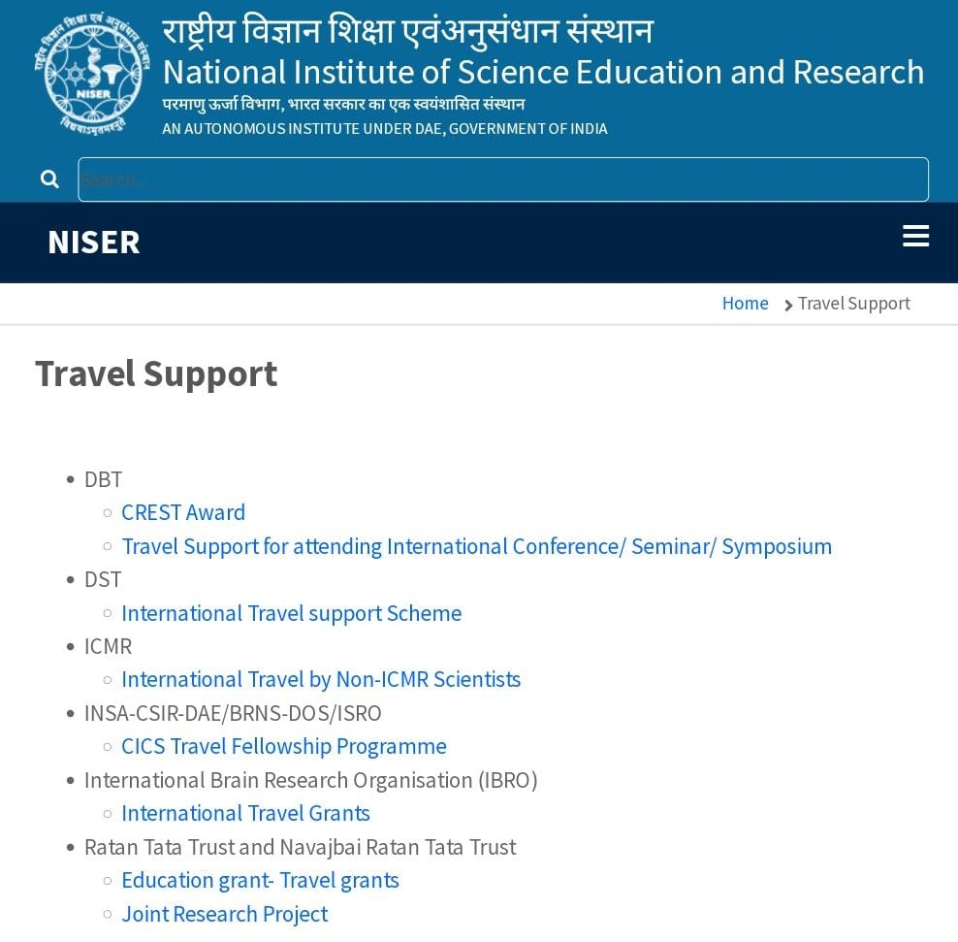
NISER Travel Support
( https://www.niser.ac.in/content/travel-support )
Some others fellowship program for women
1) Women Scientist Scheme by DST
2) Women Scientist Scheme by DBT
3) Women in Science lectures by EMBO
4) Post Doctoral Fellowship for Women

Slide 50
DST Women Scientist Scheme (WOS-A)
( https://online-wosa.gov.in/wos/ )
176) The Education Qualification for DST Women Scientist Scheme is
a) M.sc/equivalent degree b) Under graduation
c) diploma d) Any of these
177) Which organization awards women scientists by this schemes
a) Department of Science and Technology
b) Department of telecommunication
c) Department of women and child development
d) Department of health and family welfare
178) The age limit for DST Women Scientist Scheme is
a) 27 years b) 28 years
c) 29 years d) 30 years
179) Which statement is correct for DST Women Scientist Scheme ?
a) The amount of fellowship for M.sc students will be Rs. 30,000/- PM
b) Women scientists, with M.Tech, or MD/MS, DM/MCH in Medical Sciences will be given Rs.40,000/- PM
c) Women scientists having Ph.D. A degree in Basic or Applied Sciences will be entitled to a fellowship of Rs.55,000/- PM.
d) All of these

Slide 51
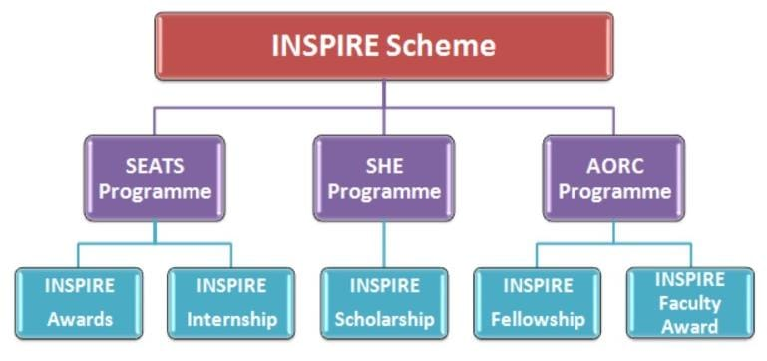
"Innovation in Science Pursuit for Inspired Research” (INSPIRE)
( https://www.online-inspire.gov.in/ )
180) INSPIRE Faculty Fellowship Scheme is a component under INSPIRE for young researchers in the age group of
a) 27-32 years b) 25-32 years
c) 27-30 years d) 25-30 years
181) How many scheme under INSPIRE ?
a) 3 b) 5 c) 4 d) 6

Slide 52
182) Which are the name of the INSPIRE schemes
a) Scheme for Early Attraction of Talent (SEATS)
b) Scholarship for Higher Education (SHE)
c) Assured Opportunity for Research Careers (AORC)
d) All of these
183) SEATS aims for the students by providing INSPIRE Award of Rs 5000 to one million young learners from class
a) VI to Class X b) VII to Class X
c) VIII to Class X d) All of these
184) The scheme SHE offers 10,000 Scholarship every year in the age group 17-22 years with Rs.
a) 80,000 b) 50,000 c) 40,000 d) 1lakh
185) Which are true ?
INSPIRE AORC is given
a) For 2 years, the selected fellows receive a monthly amount of INR 25,000. b) For the last 3 years, the fellows receive INR 28,000 per month.
c) Fellows also receive House Rent Allowance (HRA) and a contingency grant of INR 20,000 per annum.
d) All of these

Slide 53
186) I have completed my B.Sc. course. I wish to avail one-year break from studies
before joining M.Sc. course. Will my scholarship be continued?
a) Yes b) No
187) Age criterion for applying for SHE
a) 17-22 b) 18-23 c) 16- 23 d) 20-25
188) Swami Vivekananda Scholarship is also known as
a) Bikash Bhavan Scholarship b) Nabanna scholarship
189) The scholarship amount ranges from (HS, UG Honors, PG, Medical, Engineering, Nursing, Paramedical, Diploma)
a) INR 12,000 to INR 60,000 per annum.
b) INR 20,000 to INR 60,000 per annum.
c) INR 12,000 to INR 70,000 per annum.
d) INR 12,000 to INR 80,000 per annum.
190) Kanyashree K3 scholarship for
a) P.G Students b) U.G Students
191) To apply K3 student have to pass an UG degree with percentile
a) 45% b) 40% c) 60% d) 55%
192) Under K3 Scheme Science students will receive per month Rs.
a) 2500 b) 2000 c) 4000 d) 1000

